Slide 1
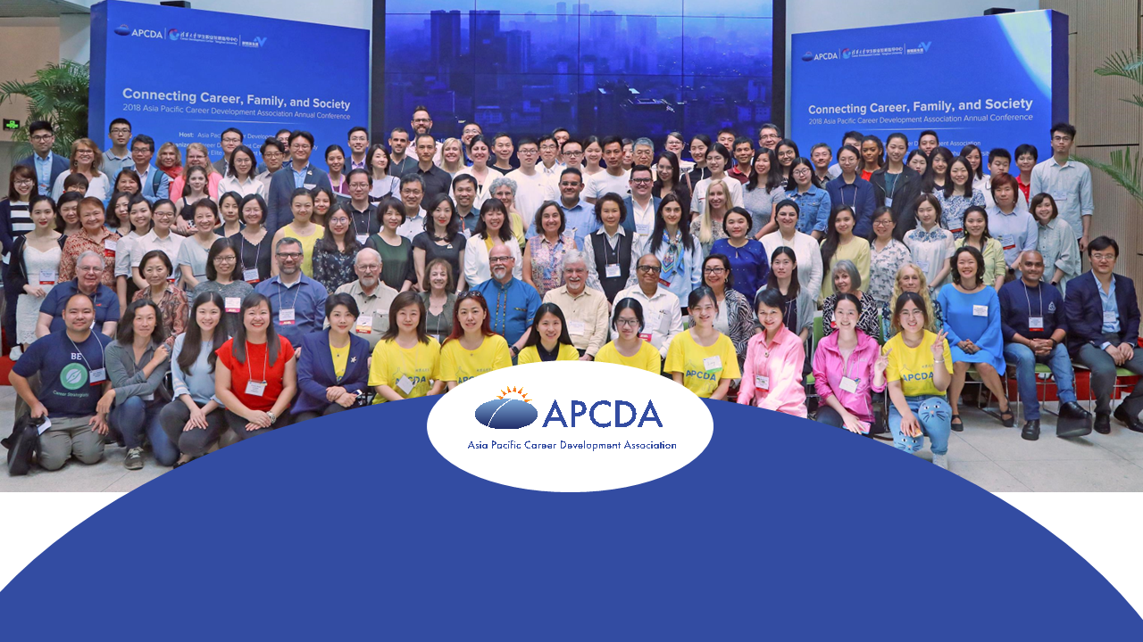
Asia Pacific Career Development Association

Slide 2
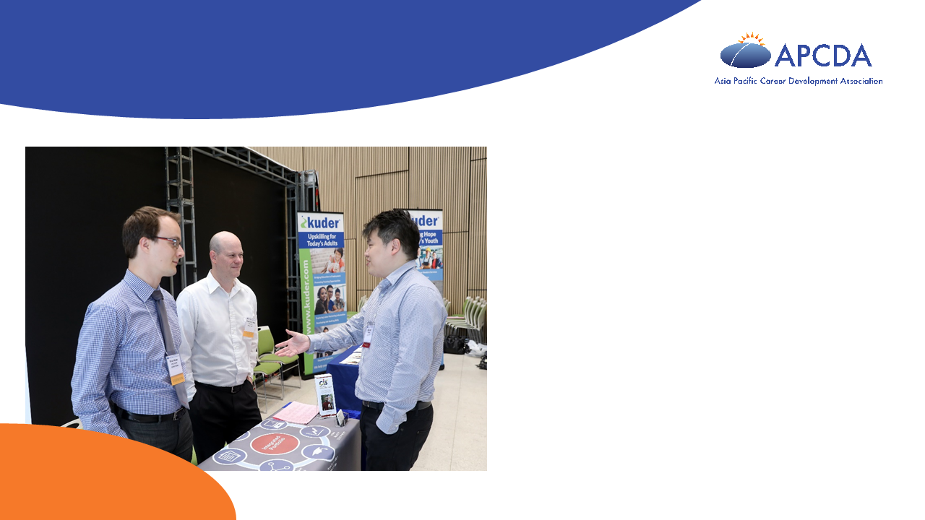
Vision & Mission
Vision
APCDA is a forum for sharing career development ideas and practices in the Asia Pacific region and engaging the world about these insights.
Mission
To promote collaboration among career practitioners throughout the Asia Pacific region
To inspire existing and potential career practitioners to deliver theory-based and research-driven career development services
To promote research in the field of career development
To advocate for workforce policies and practices that foster inclusion and access to decent work for all

Slide 3

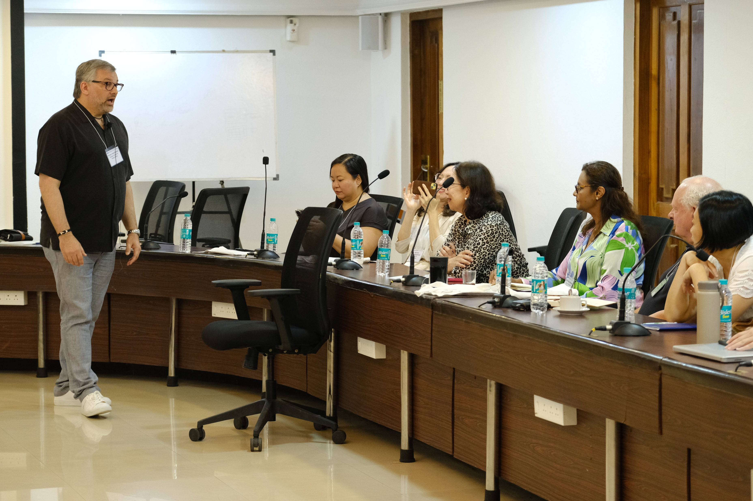
What We Offer …
Exchange of ideas at an annual conferences
Get the latest news about neighbors
Global perspective through Webinars on current topics
Sponsor networking events
Publish in scholarly journal on career development

Slide 4

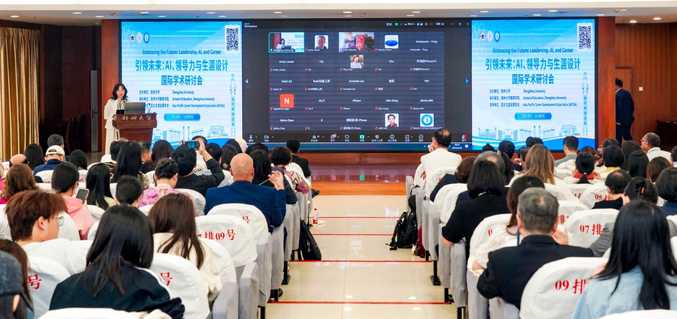
Current and Future Activities
Develop training standards
Develop joint memberships with local associations
Accredit high quality career development training programs throughout the area
Identify exemplary practices
Encourage theory development

Slide 5
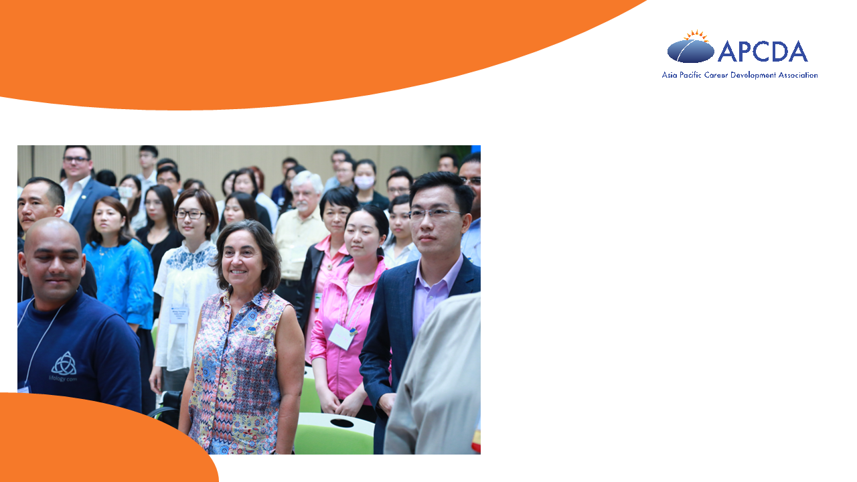
Membership Tiers
Students
Regular (employed)
Retired
Organization members (country associations, universities, training companies)
Membership fee is based on Country
High income countries
Not high-income countries (50%)

Slide 6
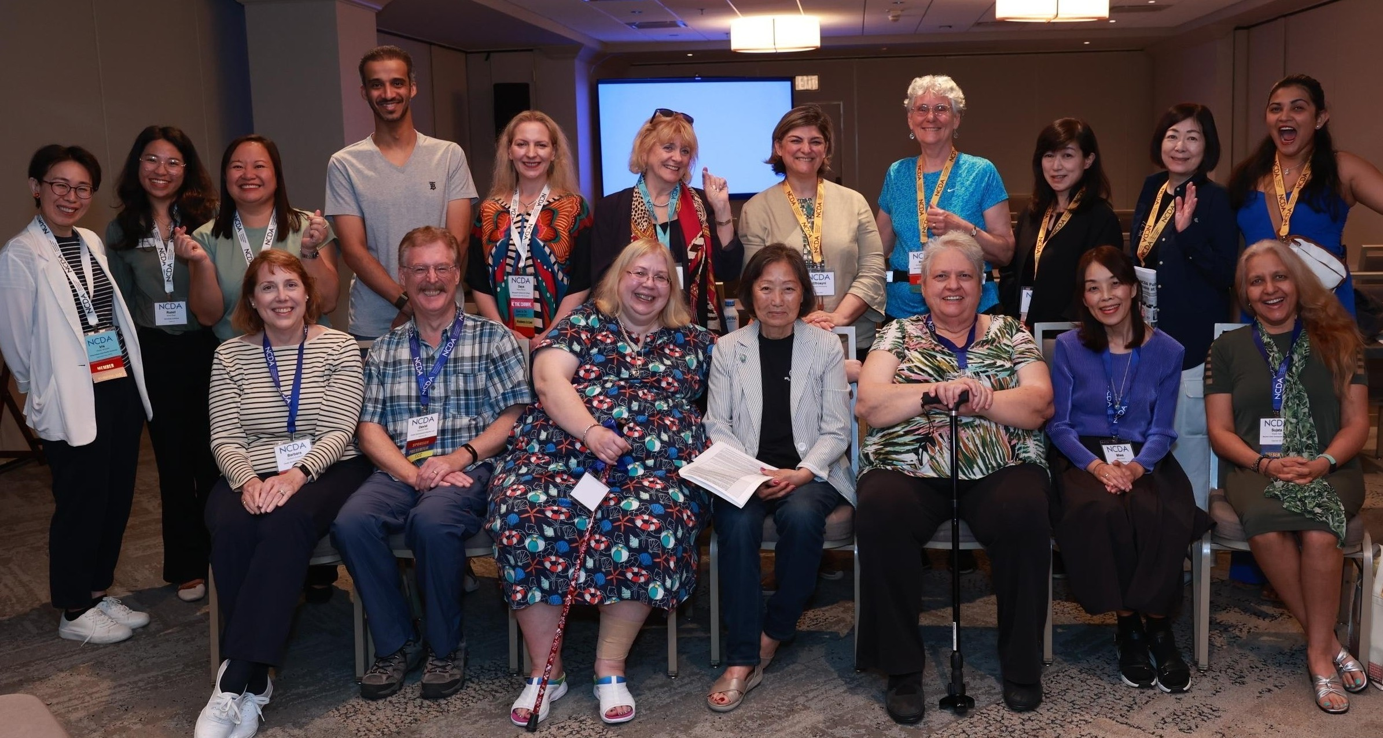
Governance
Governing Bodies
Officers
Board of Directors
Committee Council
Country/Area Council
Non-Governing Bodies
Staff
Financial Council

Slide 7
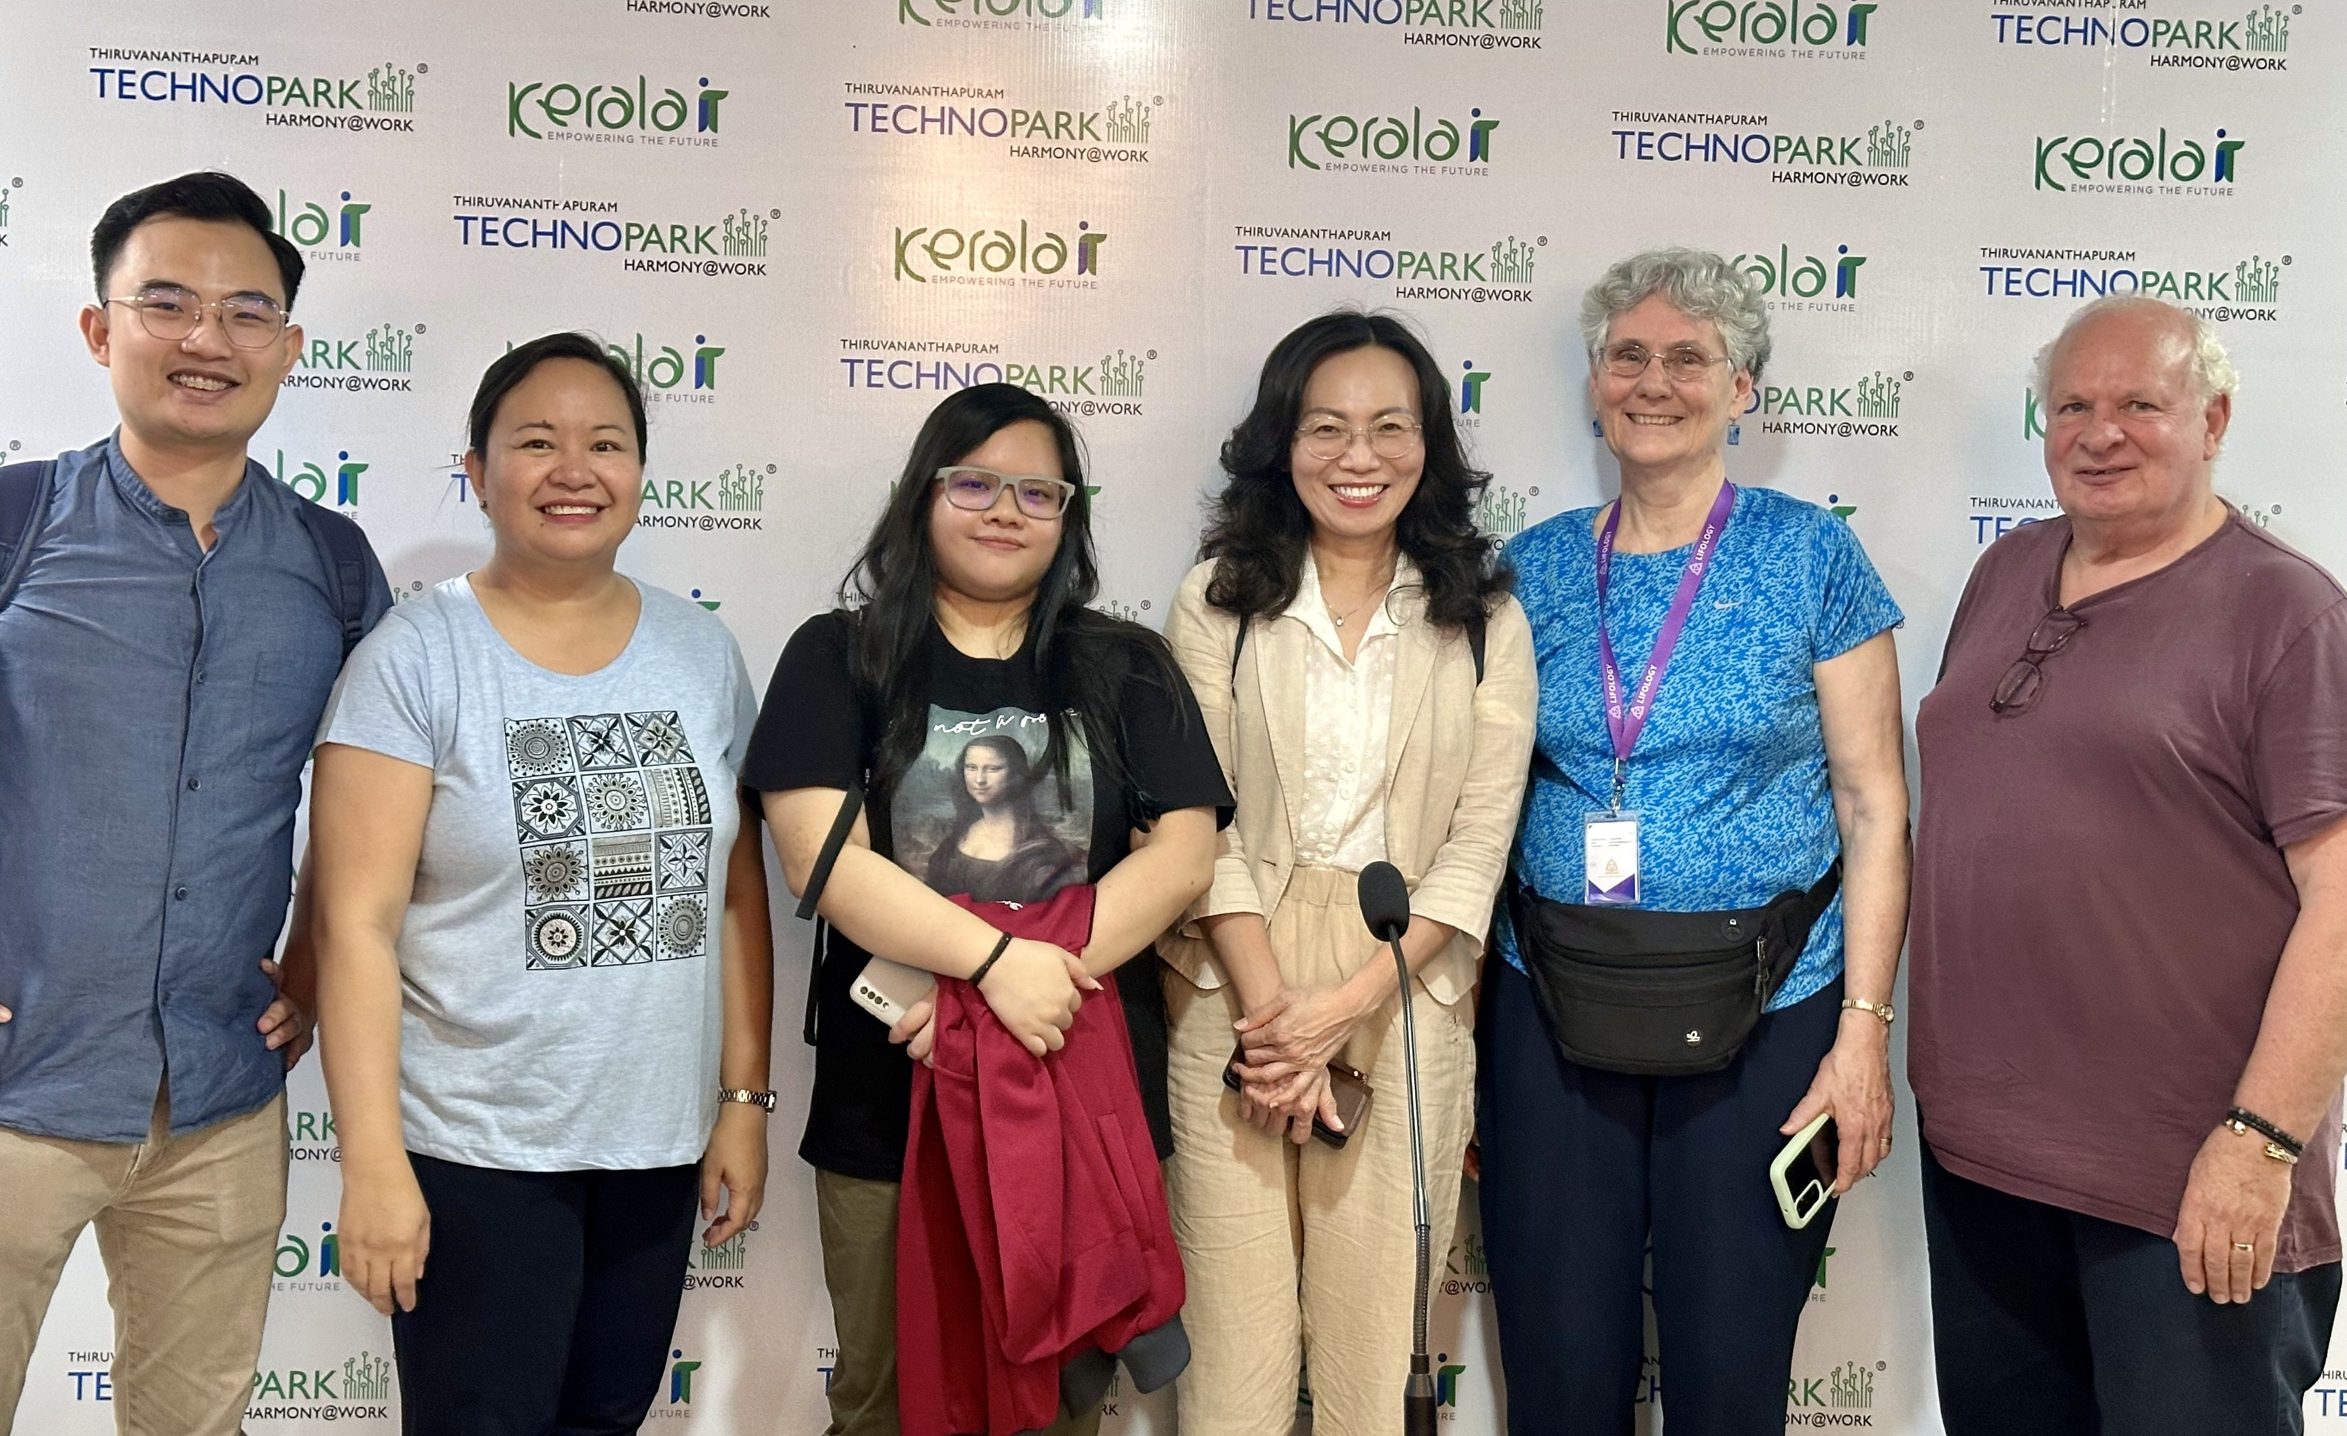
Officers
President-Elect (one year)
President (one year)
Past President (one year)
Secretary (two years)
Treasurer (two years)
Note that running for President-Elect involves a 3-year commitment

Slide 8
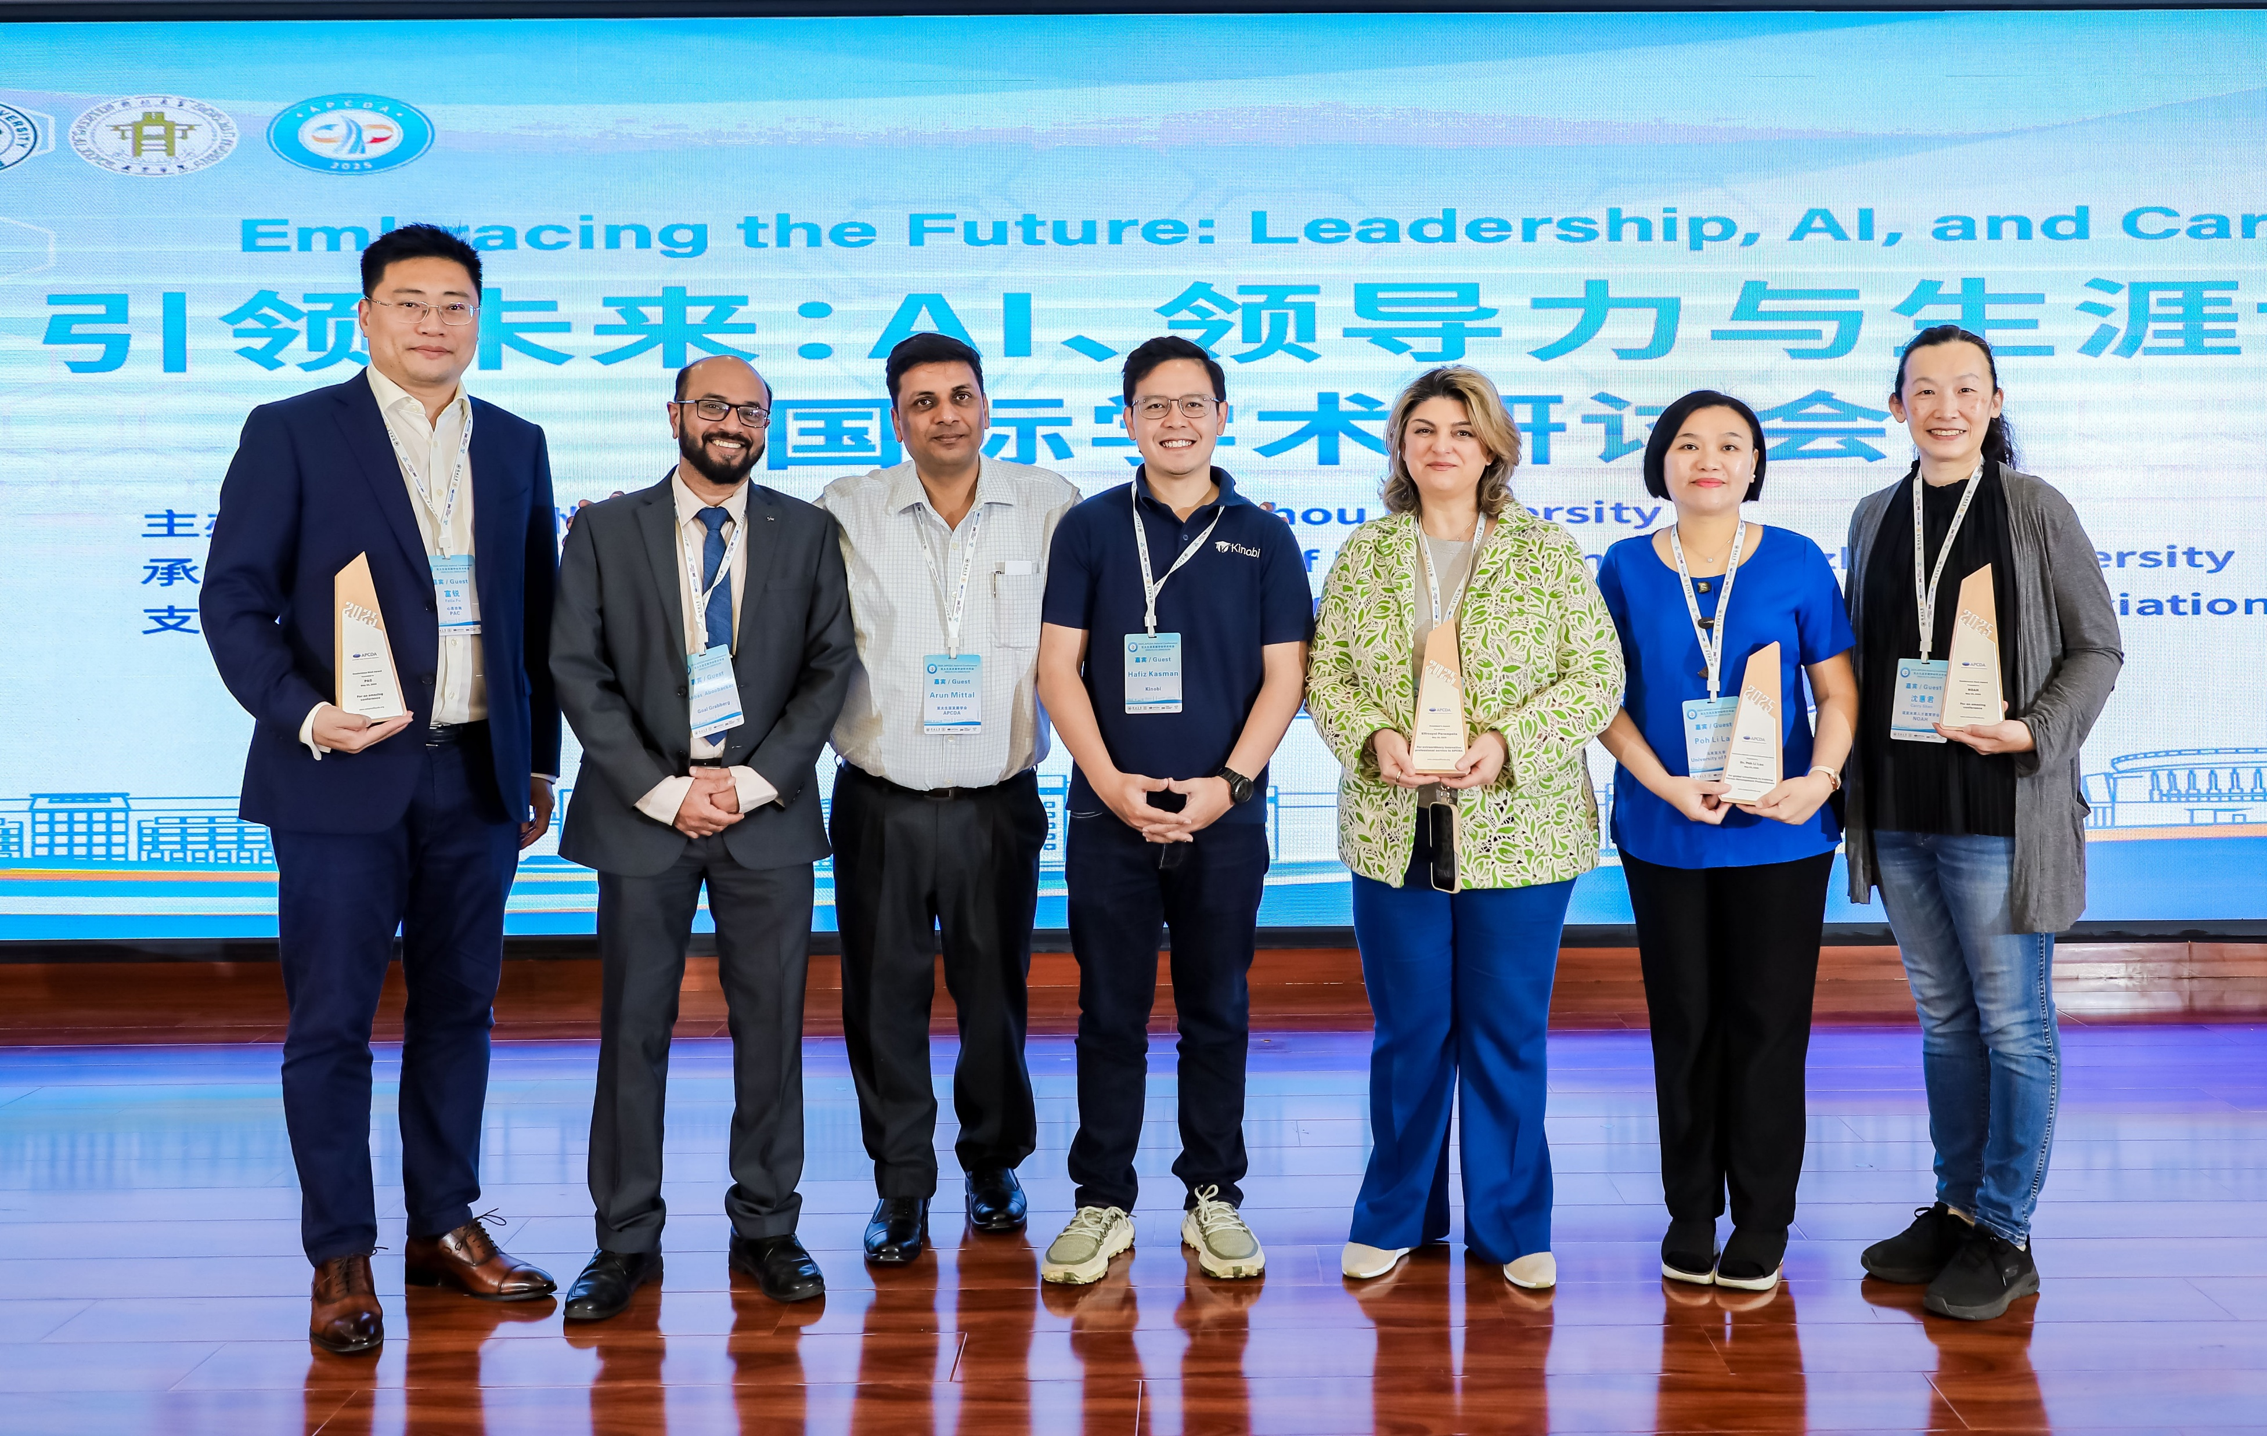
Current Officers
 | 2026-2027
President | Dr. Poh Li Lau
President Elect | Ms. Sini Parampota
Past President | Dr. Elisabeth Montgomery
Treasurer | Dr. Ma. Leonila Urrea
Secretary | Mr. Baktiar Hasnan

Slide 9

Committees
Awards & Scholarships
Bylaws & Policies
Ethics & Standards
Membership
News
Nominations
Public Relations
Programs
Research

Slide 10

Country/Area Representatives
Disseminate APCDA information within their country, which may include translating some of the information
Respond to enquiries by people from their country
Contribute newsletter articles about activities in their country

Slide 11

April 6-16, 2027, Temasek Polytechnic,
Singapore

