Slide 2
Vision & Mission
Vision APCDA is a forum for sharing career development ideas and practices in the Asia Pacific region and engaging the world about these insights. Mission
To promote collaboration among career practitioners throughout the Asia Pacific region
To inspire existing and potential career practitioners to deliver theory-based and research-driven career development services
To promote research in the field of career development
To advocate for workforce policies and practices that foster inclusion and access to decent work for all
01

Slide 3
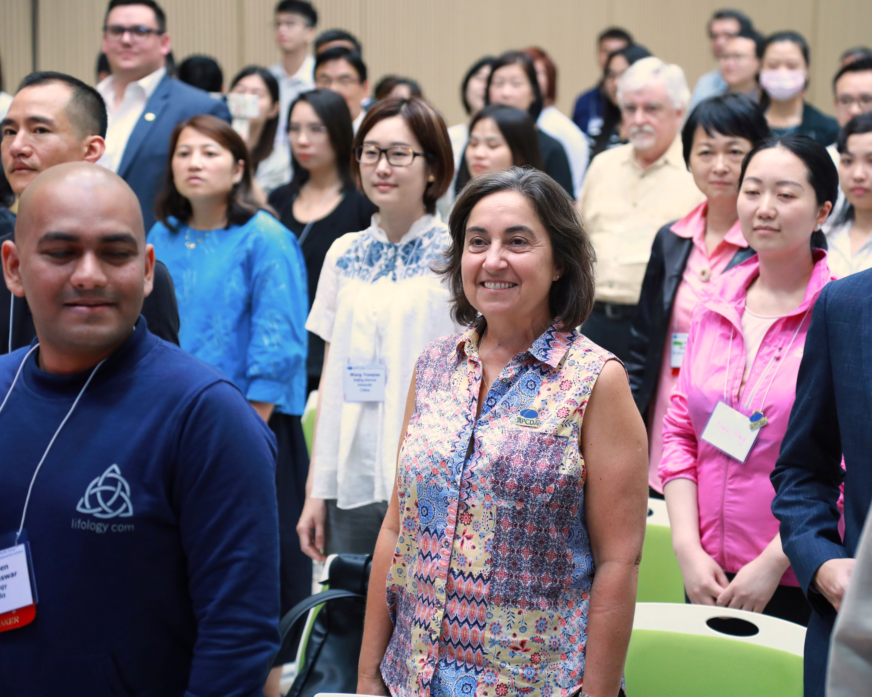
What We Offer…
Exchange of ideas at an annual conferences
Get the latest news about neighbors
Global perspective through Webinars on current topics
Sponsor networking events
Publish in scholarly journal on career development
02

Slide 4
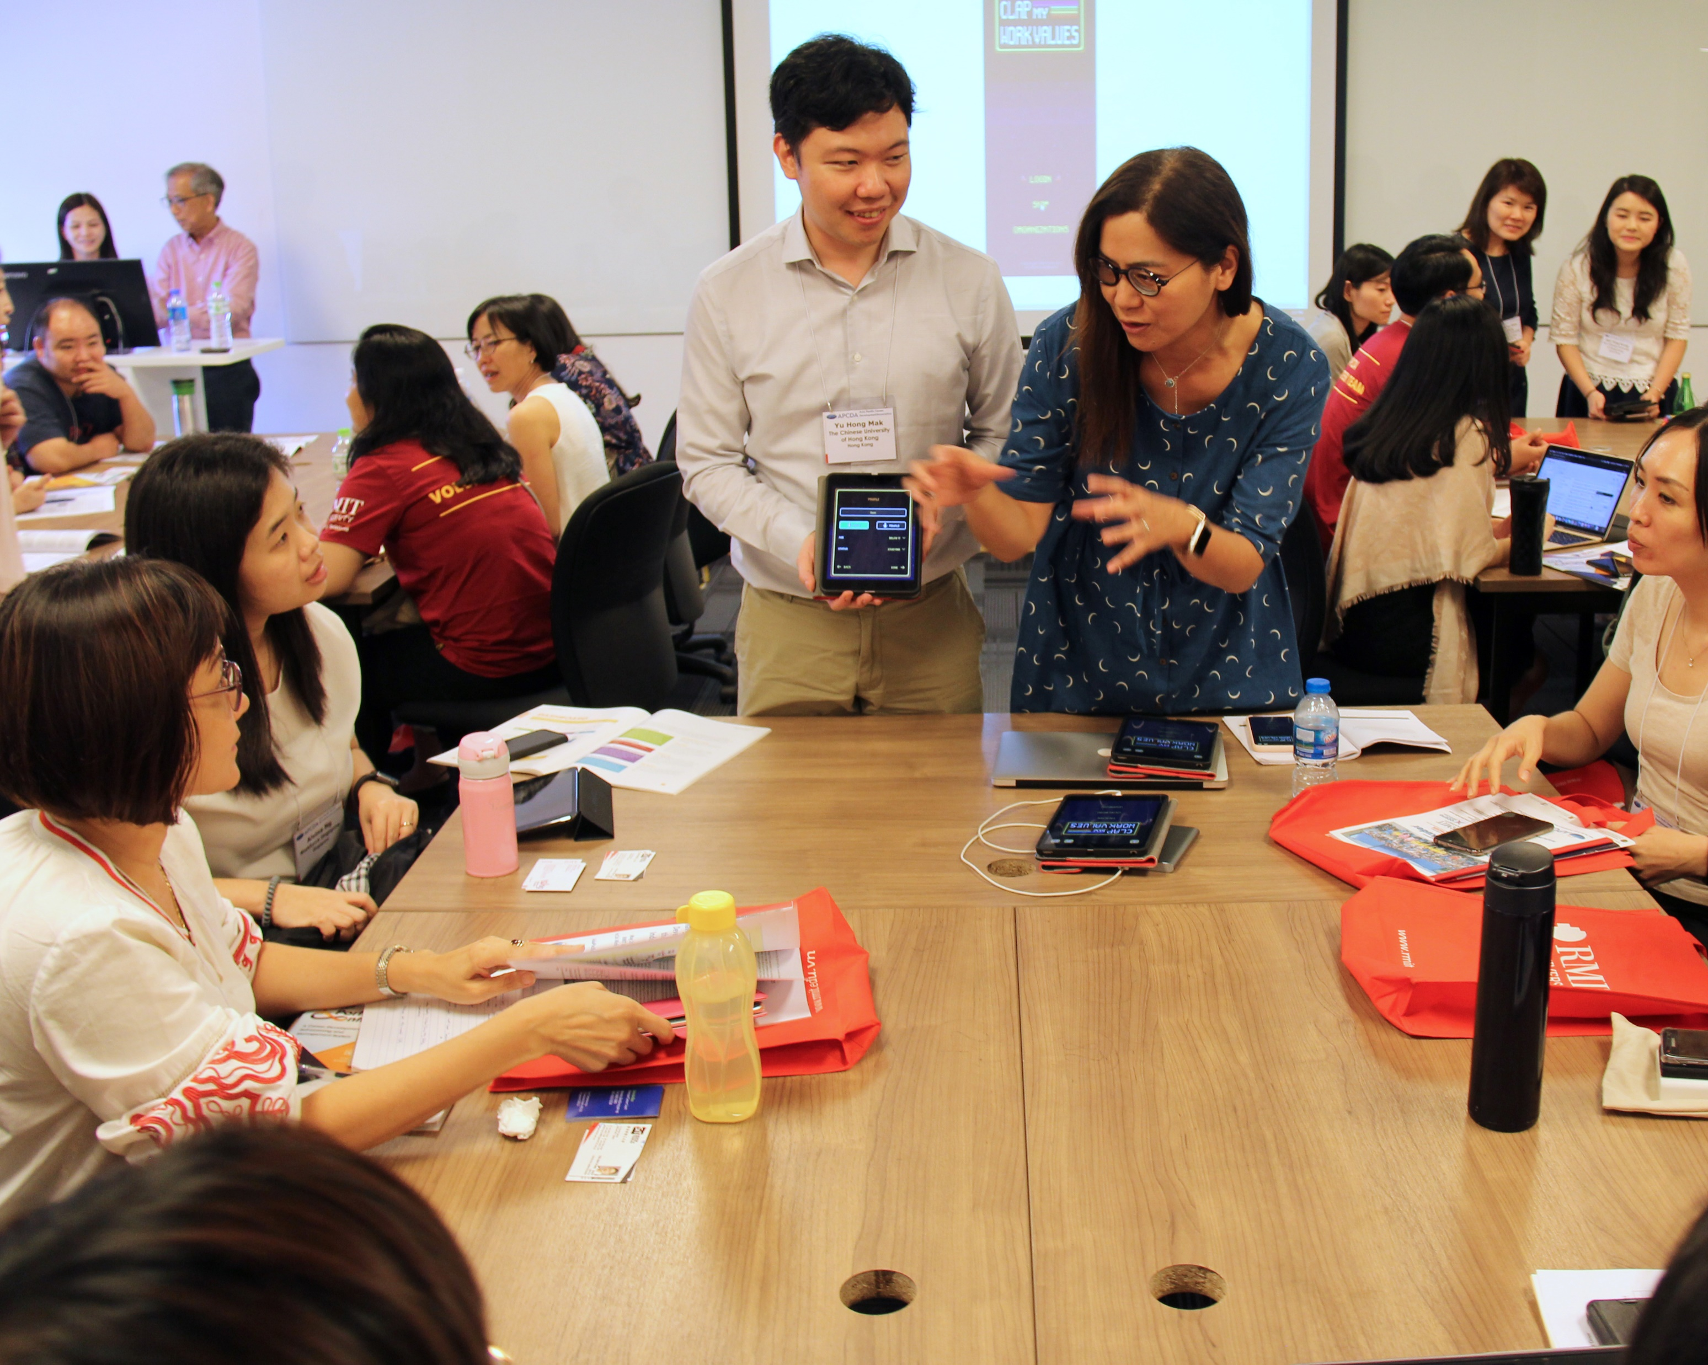
Current & Future Activities
Develop training standards
Develop joint memberships with local associations
Accredit high quality career planning programs throughout the area
Identify exemplary practices
Encourage theory development
03

Slide 5
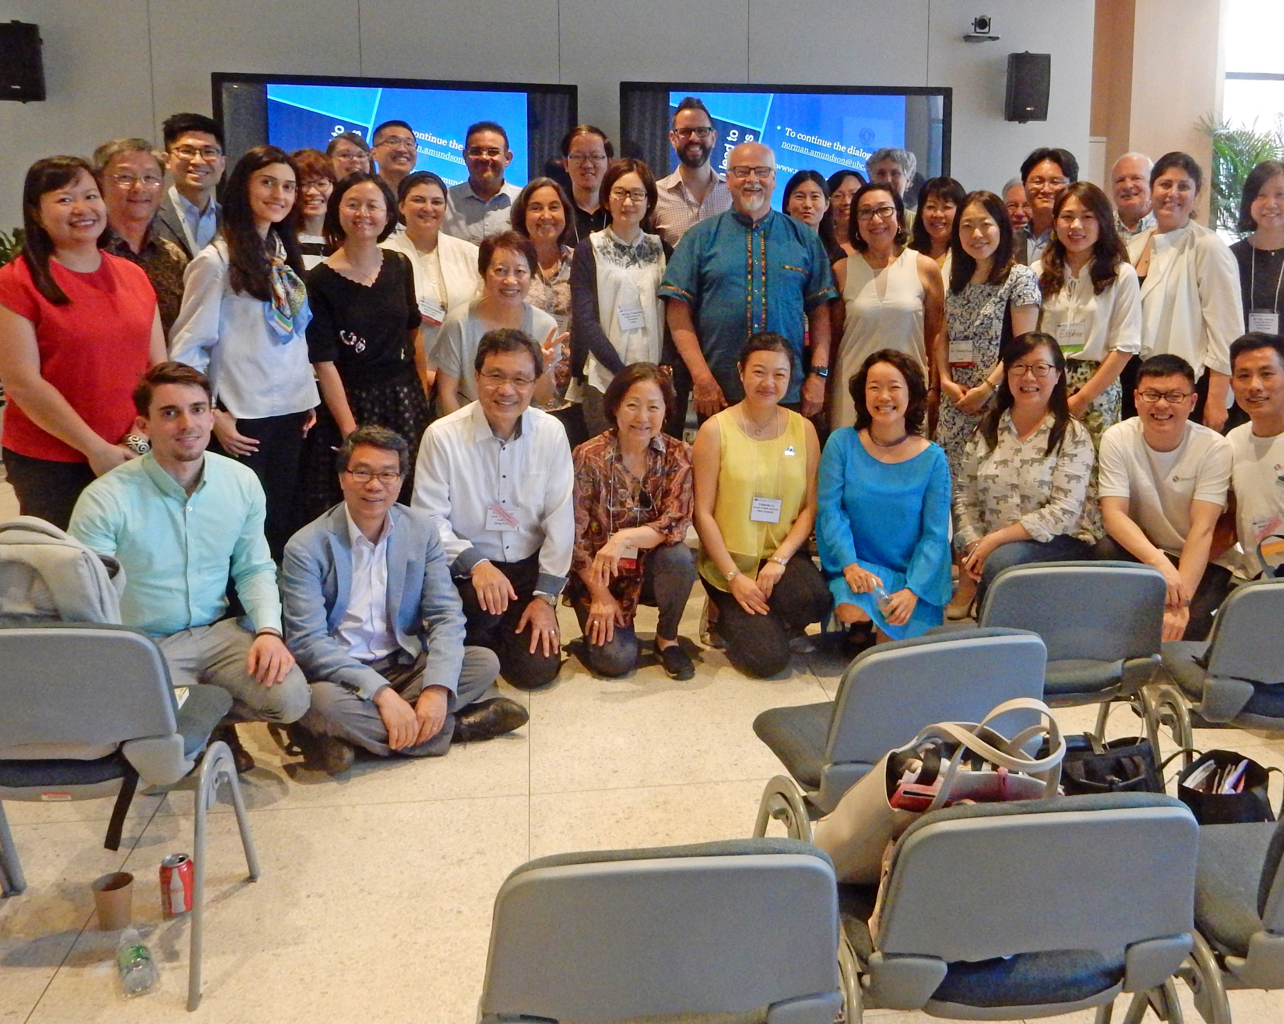
Membership Tiers
Students
Regular (employed)
Retired
Organization members (country associations, universities, training companies)
Membership fee is based on Country
High income countries
Not high-income countries (50%)
04

Slide 6
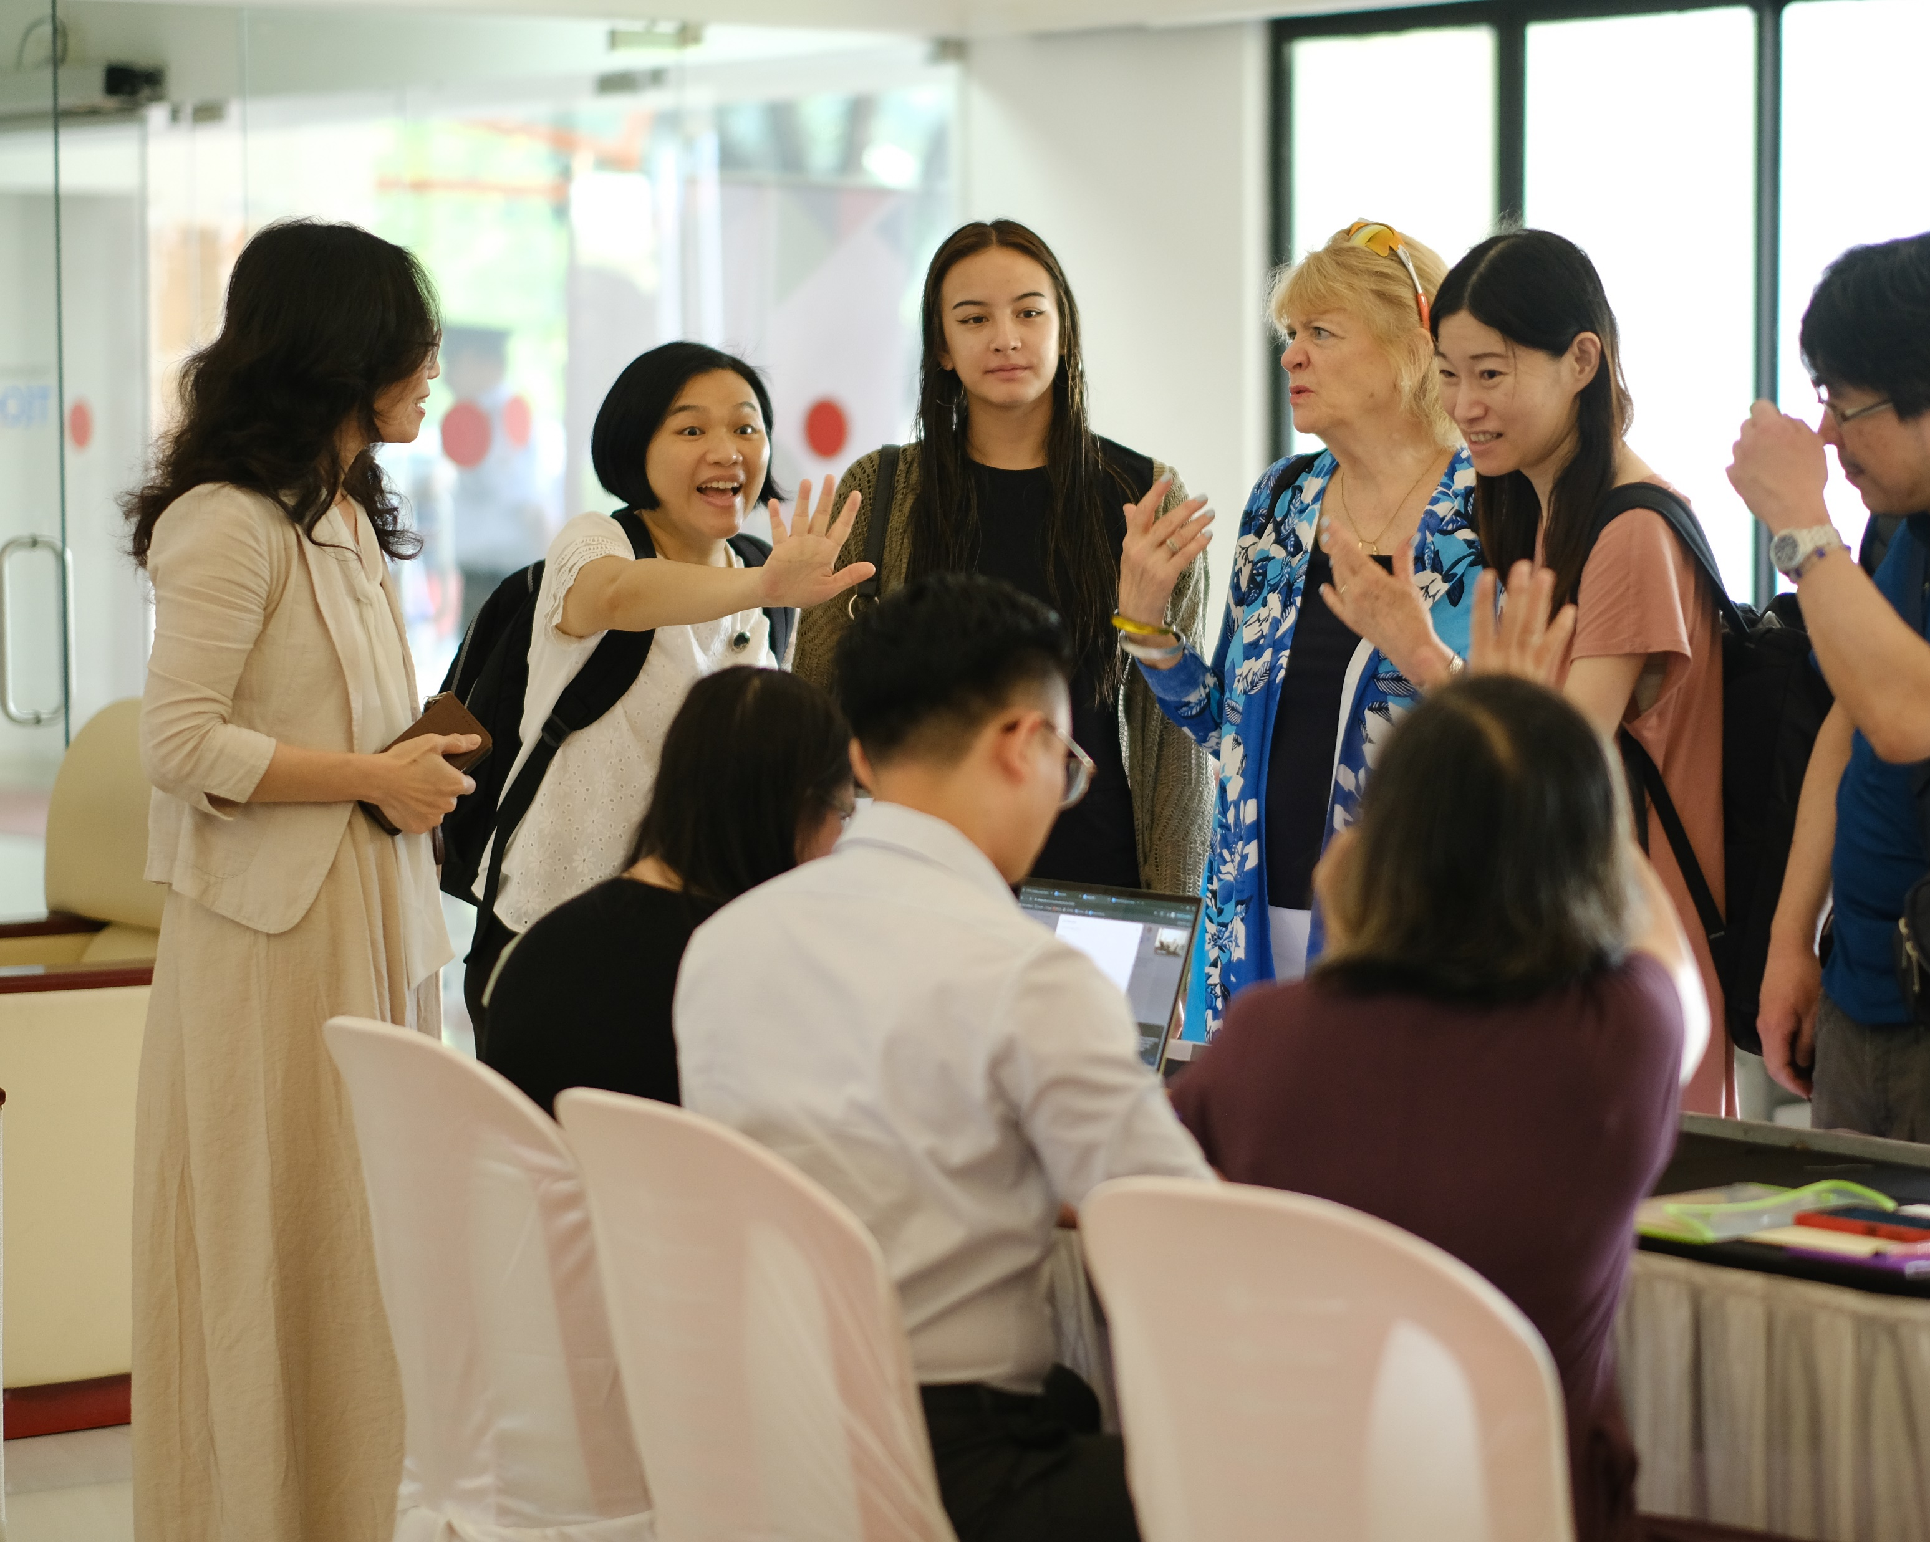
Governance
Governing Bodies
Non-Governing Bodies
Officers
Board of Directors
Committee Council
Area Council
Staff
Financial Council
05

Slide 7
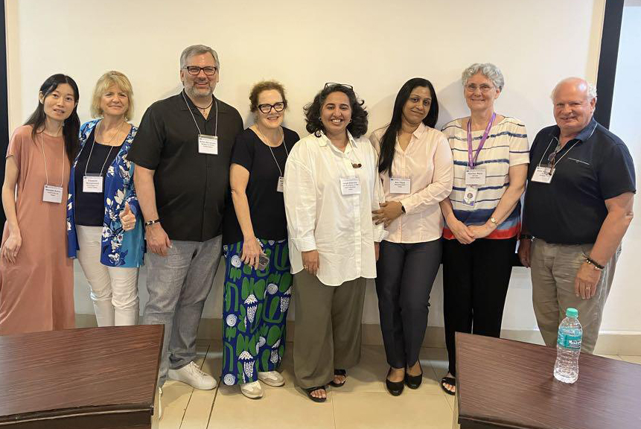
Officers
President-Elect (one year)
President (one year)
Past President (one year)
Secretary (two years)
Treasurer (two years)
(Note that running for President-Elect involves a 3-year commitment)
06

Slide 8
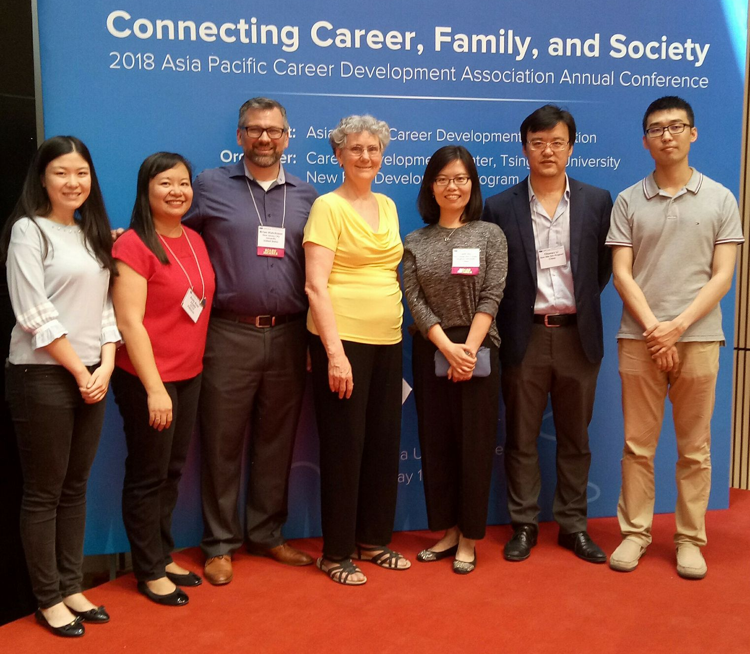
Current Officers
Year
2023-24
President
Dr. Serene Lin- Stephens
President Elect
Mr. Allan Gatenby
Past President
Ms. Momoko Asaka
Treasurer
Dr. Ma. Leonila Urrea
Secretary
Ms. Sini Parampota
07

Slide 9
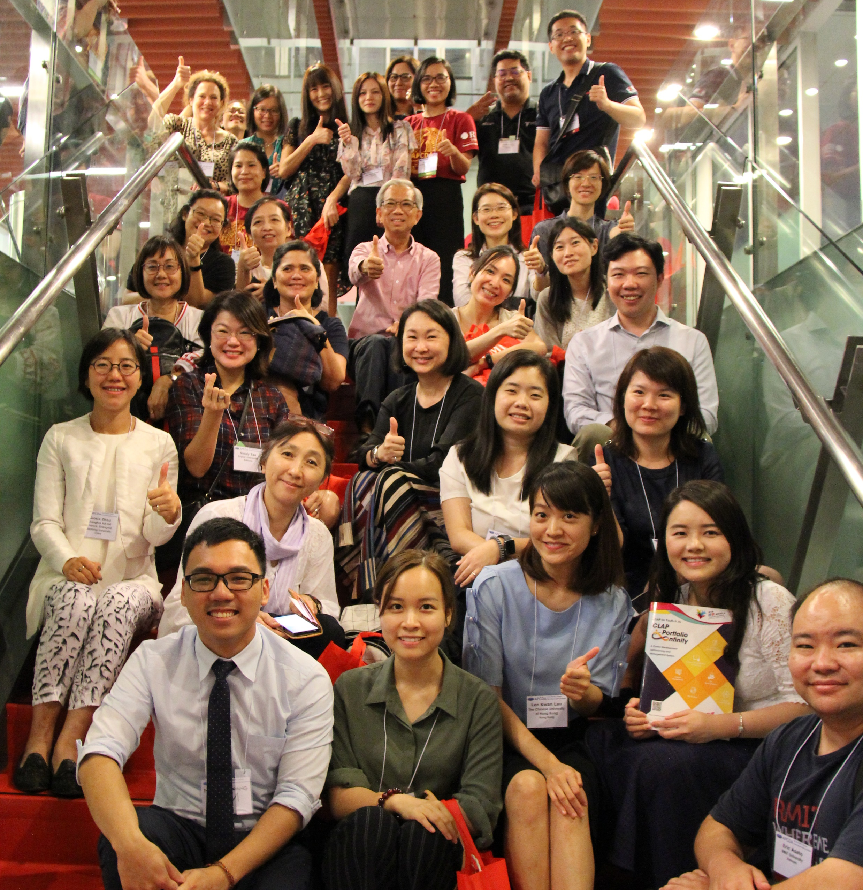
Committee
Awards & Scholarships
Bylaws & Policies
Ethics & Standards
Membership
News
Nominations
Public Relations
Programs
Research
08

Slide 10
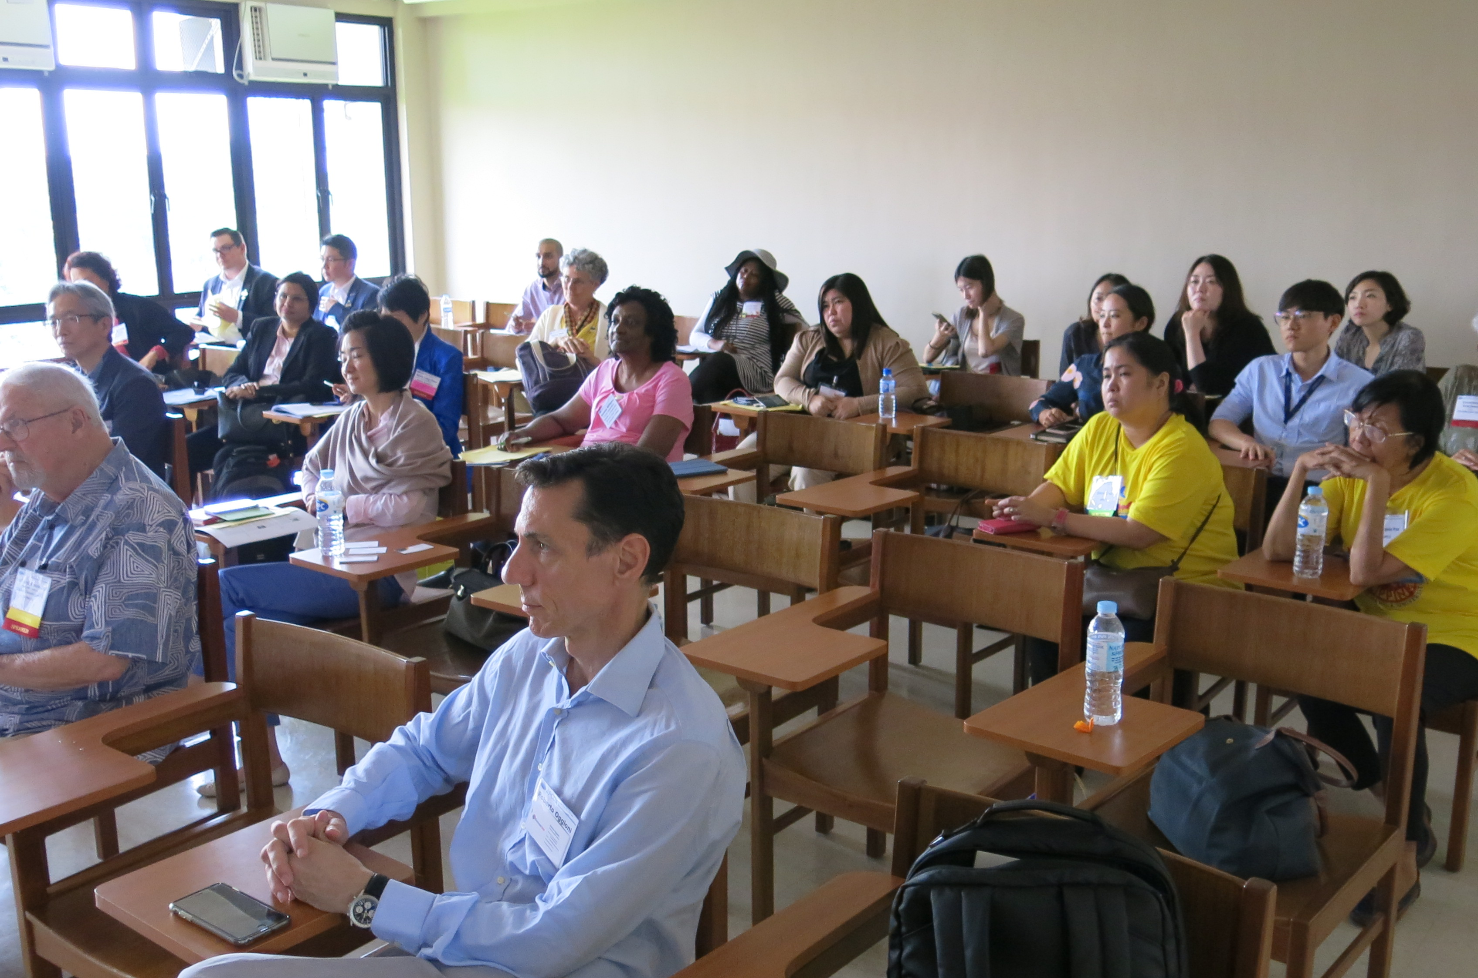
Area Council
Disseminate APCDA information within their region, which may include translating some of the information
Respond to enquiries by people from their country
Contribute newsletter articles about activities in their country
09

Slide 11
2025 APCDA Hybrid Conference
Embracing the Future Through Leadership, AI, and Career Design
May 12 - 26, 2025
Zhengzhou University, China

